Slide 1
LIFE IP CARE4CLIMATE
„Boosting greenhouse gas emissions reduction by 2020 with a view to 2030 – promoting sustainable transport, energy efficiency, renewable energies and sustainable, climate protecting land use in the transition to low carbon society“
Online meeting, 07.02. 2024

Slide 2















Partners

Slide 3
Basic information
Integrated project: link (by Angelo Salsi)
Duration: 1.1.2019 – 31.12.2026 (8 years)
Budget: 27 million EUR

Slide 4
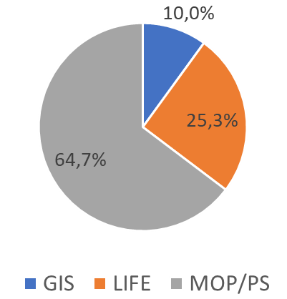
Basic information
Budget SFI: 1.505.413 € (+6,5% overheads)

Slide 5
General objectives
Tackle identified implementation gaps / bottlenecks to enable faster and more cost-effective realization
Increase resources and competencies
Setting up an efficient monitoring system for the implementation of the OP GHG
Cross-sector emission reduction
Mobilising other - complementary sources of funding

Slide 6
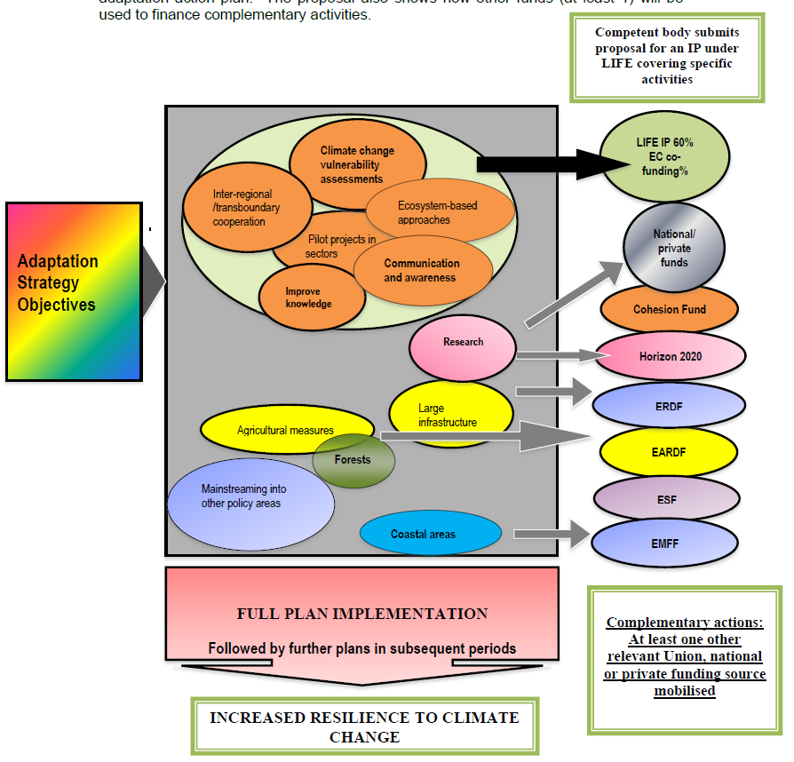
Catalization/mobilization of funds

Slide 7
C.8: TOWARDS A CLIMATE FRIENDLY LAND USE STRATEGY
C8.1: Establishment of the LULUCF monitoring system
C8.2: Strategic plan for key measures and demonstration of selected measures
C8.3: Building professional and governance capacities
C8.4: Raising information and public awareness on CCM

Slide 8
Activity: C8.1
Setting the design of a uniform carbon stock monitoring at national level for all land uses
Definition of sustainability indicators and variables
Development of a LULUCF online application
Ex-ante evaluation of existing models for carbon pools
Preparation of design of permanent experimental sites for all land uses
Set-up of a centralized database for LULUCF

Slide 9
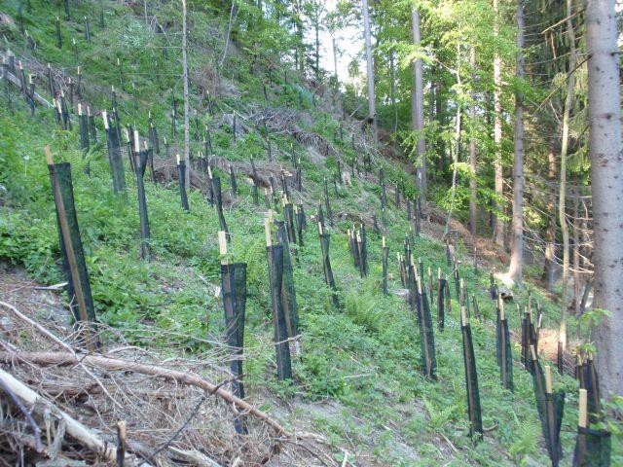
Activity C8.2
Preparation of strategic plan
Demonstration of selected measures:
  Restoration of degraded forests
  Improvement of wetland management
  Maintenance of permanent grassland

Slide 10
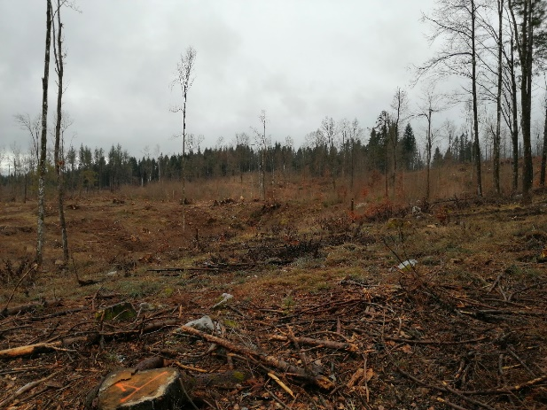
Pilot areas

Slide 11
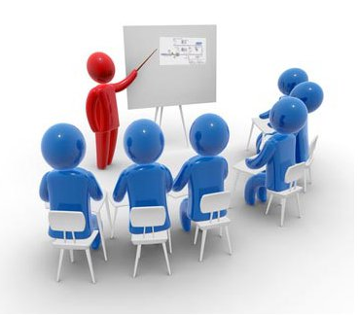
Activity C8.3
Assessment of current professional and governance capacities
Train the trainers
Education and training of professionals, policy makers and educators
Organisation of summer schools

Slide 12
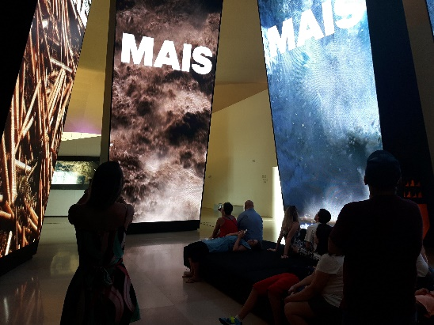
Activity C8.4
National awareness raising campaign on climate friendly land use
Strengthening cooperation with key stakeholders
Action Plan for Replication and Transfer of the Project Results

Slide 13

Questions
by Brendan Koerner

